Slide 1
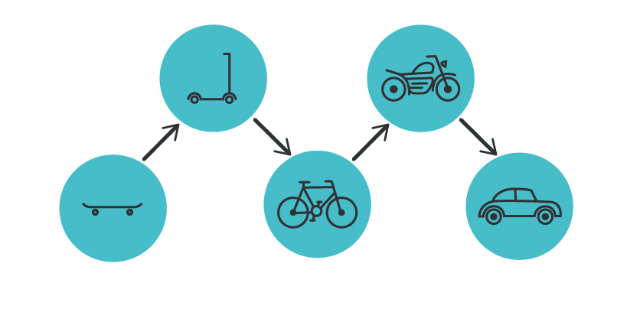

MSC3182
SOCIAL ENTREPRENEURSHIP
Lesson 5
Building an MVP

Slide 2
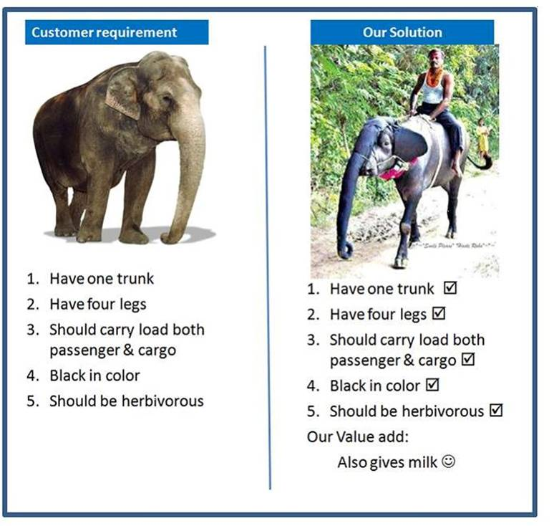
CUSTOMER REQUIREMENT Vs OUR SOLUTION

Slide 3
MINIMUM VIABLE PRODUCT (MVP)
A product with just enough features to satisfy early customers, and to provide feedback for future development
The final, complete set of features is only designed and developed after considering feedback from the product's initial users
This strategy targets avoiding building products that customers do not want and seeks to maximize information about the customer per amount of money spent.
An MVP has three key characteristics:
It has enough value that people are willing to use it or buy it initially.
It demonstrates enough future benefit to retain early adopters.
It provides a feedback loop to guide future development.

Slide 4

REQUIREMENTS OF AN MVP
The two fundamental requirements an MVP
Needs to fully address a need or solve a problem for the user
The MVP needs to delight the user.
Customer delight is surprising a customer by exceeding his or her expectations and thus creating a positive emotional reaction.
This emotional reaction leads to word of mouth.

Slide 5
REQUIREMENTS OF AN MVP
Needs to fully address a need or solve a problem for the user
You cannot simply choose three of seven features on your product roadmap and decide that once you’ve built out those three features you will have a minimum viable product to ship.
Always make sure that your MVP, in at least one area of its promised functionality, provides the user with a complete solution.

Slide 6
REQUIREMENTS OF AN MVP
The MVP needs to delight the user.
This is the key ingredient so many minimum viable products neglect to include.
If you don’t have something in your product that delights the user in some way, you do not have a true MVP.
Customer delight is a must-have in your products

Slide 7
DIFFERENCE BETWEEN SOLUTION DEMO AND MVP
Solution demo and MVP capture the core essence of your actual solution
Both help you manage your risk related to
customer,
product or
market

Slide 8
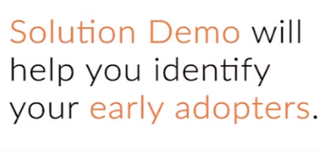
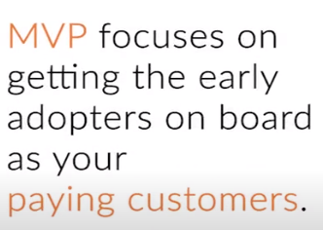
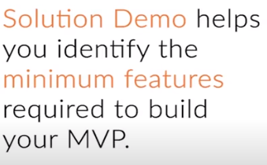
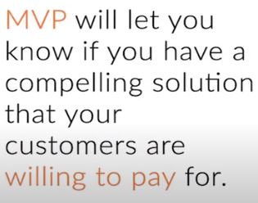
DIFFERENCE BETWEEN SOLUTION DEMO AND MVP

Slide 9
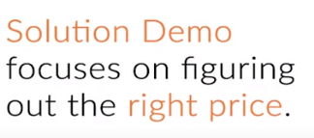
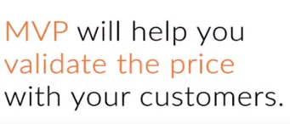


DIFFERENCE BETWEEN SOLUTION DEMO AND MVP

Slide 10

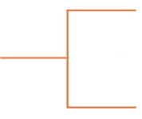





DIFFERENCE BETWEEN SOLUTION DEMO AND PROTOTYPE

Slide 11
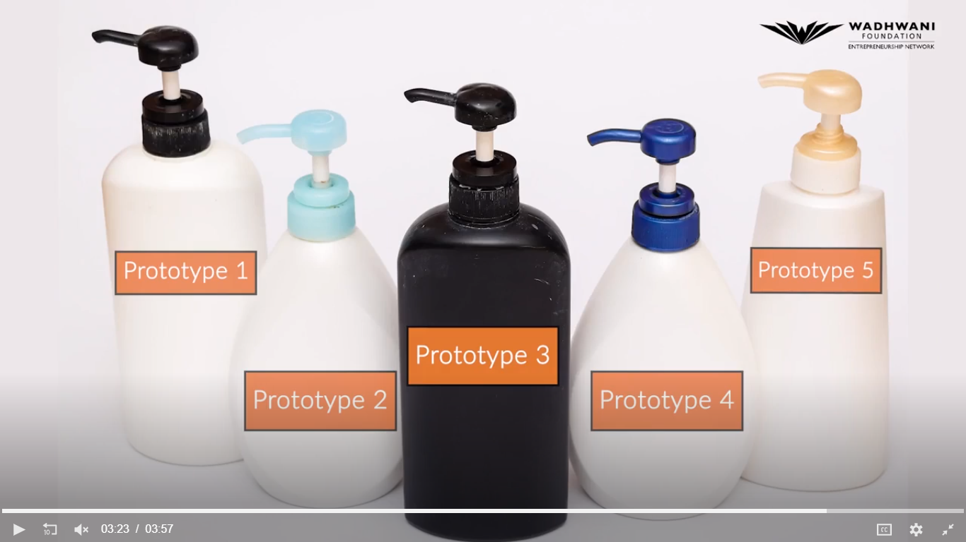
DIFFERENCE BETWEEN SOLUTION DEMO AND PROTOTYPE

Slide 12





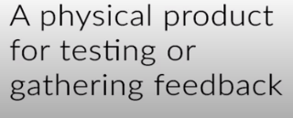
CONCLUDING REMARKS

Slide 13
TIPS
Build an MVP

Slide 14
TIPS TO BUILD YOUR MVP
Clear your slate
Don’t automatically assume the features that need to be included in your MVP.
Start with a clean slate and justify the addition of each one.
Use the key takeaways from your product demo and solution interviews to decide which features to include.
Note:
Unlike your solution mockup or demo, your MVP needs to be a complete product having minimum features and solving the most critical problem that you identified such that it can be sold in the market.
Your MVP should be able to deliver some value to the customers.

Slide 15
TIPS TO BUILD YOUR MVP
Start with your number-one problem.
The job of your Unique Value Proposition (UVP) is to make a compelling promise.
The job of the MVP is to deliver on that promise.
The essence of your MVP should be captured in the mock-up of your number one problem. Start there.
Deliver per the Jobs To Be Done (JTBD) framework .
Remember the customer needs that you had identified in the JTBD framework?
Your MVP needs to satisfy the functional, emotional, personal, or social aspects of the customer’s needs.

Slide 16
TIPS TO BUILD YOUR MVP
Eliminate nice-to-have features that are not essential.
From your Solution interviews, you should be able to label every element on your mock-up as ‘’must-have,’’ ‘’nice-to-have,’’ or ‘‘don’t need.’’
Immediately eliminate the “don’t-needs”, and add the “nice-to-haves” to your features backlog queue unless it is a prerequisite to a “must-have” feature.
Consider other customer feature requests.
During your demo and solution interviews, your customers may have highlighted certain features that are needed to make your product complete or usable.
Visit these next, and add/defer them based on the level of need.

Slide 17
TIPS TO BUILD YOUR MVP
Remember, your MVP will be chargeable.
Your MVP being a complete product, with minimum features, needs to have a go-to-market price.
If your product or solution is a software, you can have a trial period.
However, a trial period is not recommended at this stage.
If you really want to offer a free trial to your customers, make sure that it does not exceed 30 days.
Taking your MVP to the market is another way of validating if your customers want to pay for your product or solution.

Slide 18
TIPS TO BUILD YOUR MVP
Focus on learning, not optimization
All your energy needs to be channeled toward accelerating learning.
Speed is key.
Think about optimizing production and costs later.

Slide 19

THANK YOU

